Slide 1

Getting Started with NumPy
What is NumPy?
NumPy (Numerical Python) is a Python library for working with arrays and performing numerical computations efficiently.
Why Use NumPy?
Supports multi-dimensional arrays.
Provides mathematical functions for fast array operations.
Optimized for performance compared to Python lists.
Importing the Library:
import numpy as np

Slide 2
Creating Arrays
From a List:
# Convert list to array
arr = np.array([1, 2, 3, 4])
print(arr)
2. Using Built-in Functions:
# Create an array of zeros
zeros = np.zeros((2, 3))
print(zeros)
3. Built-in Functions:
# Create an array of ones
ones = np.ones(5)
print(ones)
4. From array with range:
# Create an array with a range
range_arr = np.arange(0, 10, 2) # Start, Stop, Step
print(range_arr)

Slide 3
Indexing Arrays
One-dimensional Arrays:
arr = np.array([10, 20, 30, 40]) print(arr[0]) # Access first element print(arr[-1]) # Access last element
2. Multi-dimensional Arrays:
arr = np.array([[1, 2, 3], [4, 5, 6], [7, 8, 9]])
print(arr[1, 2]) # Access element at row 2, col 3
print(arr[0, :]) # Access all elements in the 1st row
print(arr[:, 1]) # Access all elements in the 2nd col
3. Array Transposition
Transpose a Matrix:
arr = np.array([[1, 2], [3, 4], [5, 6]]) print(arr.T) # Transpose rows and cols
Use Case: Transpose data for visualization or mathematical operations.
4. Shape Manipulation
Reshaping Arrays:
arr = np.array([1, 2, 3, 4, 5, 6])
reshaped = arr.reshape(2, 3) # 2 rows, 3 cols print(reshaped)

Slide 4
Array Operations and Broadcasting
2. Broadcasting: Broadcasting allows operations between arrays of different shapes.
Example: Adding a scalar to a matrix.
arr = np.array([[1, 2], [3, 4]])
print(arr + 5) # Add 5 to every element
Element-wise Operations:
arr = np.array([1, 2, 3])
print(arr + 10) # Add 10 to each element
print(arr * 2) # Multiply each element by 2
End-of-Module Practice Tasks
Create a 3x3 array of random numbers and calculate its transpose.
Generate an array with numbers from 0 to 50, filter out numbers greater than 30, and print the result.
Reshape a one-dimensional array [1, 2, 3, 4, 5, 6] into a 2x3 matrix.
Perform element-wise addition, subtraction, multiplication, and division on two arrays of your choice.
3. Matrix Multiplication:
a = np.array([[1, 2], [3, 4]])
b = np.array([[5, 6], [7, 8]]) print(np.dot(a, b)) # Matrix multiplication

Slide 5
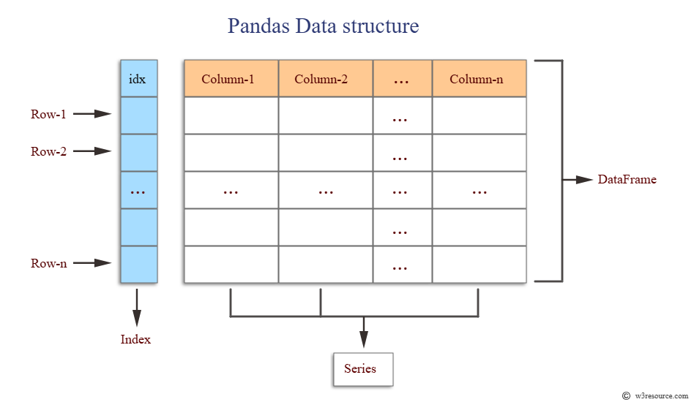
Getting Started with Pandas –
The DataFrame
What is a DataFrame?
A 2-dimensional labeled data structure with columns (features) and rows (records). It's essentially a powerful, programmable Excel spreadsheet inside Python.

Slide 6

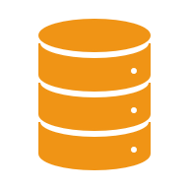
Creating DataFrames
Objective: Create DataFrames manually or from existing data.
1. From a Dictionary:
data = { "Name": ["Alice", "Bob", "Charlie"],
"Age": [25, 30, 35],
"City": ["London", "Paris", "New York"] }
df = pd.DataFrame(data)
print(df)
2. From a List of Lists:
data = [ ["Alice", 25, "London"], ["Bob", 30, "Paris"], ["Charlie", 35, "New York"] ]
df = pd.DataFrame(data, columns=["Name", "Age", "City"])
print(df)

Slide 7
Playing with Rows and Columns
Objective: Access and manipulate rows and columns in DataFrames.
Selecting Columns:
print(df["Name"]) # Select a single column
print(df[["Name", "City"]]) # Select multiple columns
2. Selecting Rows:
print(df.iloc[0]) # Select the first row
print(df.loc[df["Age"] > 30]) # Select rows where Age > 30
3. Adding and Removing Columns:
df["Salary"] = [50000, 60000, 70000] # Add a new column
df.drop("Salary", axis=1, inplace=True) # Remove a column

Slide 8

Data Cleaning & Preparation
The most important step!
Garbage in = Garbage out.
Common Tasks:
  Missing Data: df.isnull().sum() to find them. df.dropna() or df.fillna(0) to handle them.
  Wrong Data Types: df['column_name'] = df['column_name'].astype(int)
  Duplicates: df.drop_duplicates()
  Rename Columns: df.rename(columns={'old_name': 'new_name'})

Slide 9
Data Wrangling: Join, Combine, Reshape
Merging Datasets: Like SQL JOINs.
  pd.merge(df1, df2, on='common_column')
Grouping & Aggregation: The "Pivot Table" of Pandas.
  df.groupby('Category')['Sales'].sum() -> "Show me total sales by category."
Handling Missing Values
Objective: Handle null or missing values in datasets.
1. Detect Missing Values:
print(df.isnull().sum()) # Check for missing values
2. Fill Missing Values:
df["Age"].fillna(df["Age"].mean(), inplace=True) # Fill with mean
3. Drop Missing Values:
df.dropna(inplace=True) # Drop rows with missing values

Slide 10
Aggregating Data - Objective: Perform group-wise operations on datasets
1. Group By and Aggregate:
grouped = df.groupby("City")["Age"].mean()
print(grouped)
2. Count Values:
print(df["City"].value_counts()) # Count occurrences of each city
Merge Operations on DataFrames
Objective: Combine datasets using merge operations.
Inner Join:
df1 = pd.DataFrame({"ID": [1, 2], "Name": ["Alice", "Bob"]})
df2 = pd.DataFrame({"ID": [2, 3], "Age": [30, 35]})
merged = pd.merge(df1, df2, on="ID", how="inner")
print(merged)

Slide 11
Aggregating Data – contd..
2. Outer Join:
merged = pd.merge(df1, df2, on="ID", how="outer") print(merged)
3. Left Join:
merged = pd.merge(df1, df2, on="ID", how="left") print(merged)
End-of-Module Practice Tasks
Load a dataset from a CSV file, display its first 10 rows, and save the modified dataset to a new CSV file.
Create a DataFrame with columns for product names, prices, and categories. Add a new column for discounted prices.
Identify missing values in a dataset and fill them with the median value of the respective column.
Perform a group-by operation on a dataset to find the average sales by region.
Merge two DataFrames containing employee and department data using an inner join.

Slide 12

Getting Started with Pandas
What is Pandas?
Pandas is a Python library for data manipulation and analysis. It provides data structures like Series (1D) and DataFrames (2D).
Why Use Pandas?
Simplifies data cleaning and exploration.
Provides functions for filtering, aggregation, and merging datasets.
Installation:
pip install pandas
Importing the Library:
import pandas as pd

Slide 13
Pandas - Reading Local Datasets
Read CSV Files:
# Read a CSV file
df = pd.read_csv("data/sales_data.csv") print(df.head()) # Display the first 5 rows
3. Read JSON Files:
# Read a JSON file
df = pd.read_json("data/data.json") print(df.head())
2. Read Excel Files:
# Read an Excel file df = pd.read_excel("data/sales_data.xlsx", sheet_name="Sheet1") print(df.head())
4. Read TSV Files:
# Read a TSV file
df = pd.read_csv("data/sales_data.tsv") print(df.head()) # Display the first 5 rows

Slide 14
Writing Data Using Pandas - Save modified datasets back to files.
Write to CSV:
# Save DataFrame to CSV df.to_csv("output/updated_data.csv", index=False)
3. Write to JSON:
# Save DataFrame to JSON df.to_json("output/data.json")
2. Write to Excel:
# Save DataFrame to Excel df.to_excel("output/updated_data.xlsx", index=False)
4. Write to TSV:
# Save DataFrame to TSV df.to_json("output/data.tsv")

Slide 15
Data Visualization - Seeing is Believing
Objective: Equip learners with the knowledge and skills to create compelling visualizations using Python, focusing on Matplotlib and other Python visualization libraries.
What is Matplotlib?
Matplotlib is a popular Python library used to create static, interactive, and animated visualizations.
Why Use Matplotlib?
Provides detailed control over chart appearance.
Supports a wide range of plots.
Importing Matplotlib:
import matplotlib.pyplot as plt

Slide 16

Basics of Matplotlib Figures
Objective: Understand the anatomy of a Matplotlib figure.
Key Components:
Figure: The overall window or page where plots are drawn.
Axes: The area where data is plotted (can contain multiple Axes).
Plot Elements: Titles, labels, legends, etc.
2. Create a Basic Figure:
plt.figure(figsize=(8, 6)) # Create a figure with specific dimensions
plt.plot([1, 2, 3], [4, 5, 6]) # Plot a line
plt.show() # Display the plot

Slide 17
Creating Line Plots
Objective: Learn to plot basic line graphs.
Simple Line Plot:
x = [1, 2, 3, 4]
y = [10, 20, 25, 30]
plt.plot(x, y)
plt.title("Line Plot Example")
plt.xlabel("X-axis")
plt.ylabel("Y-axis")
plt.show()
2. Customize Line Styles:
plt.plot(x, y, linestyle='--', color='red', marker='o') # Dashed line with red color and circle markers
plt.show()

Slide 18
Adding Texts, Legends, and Labels
Objective: Enhance plots with descriptive elements.
Adding Text:
plt.plot(x, y)
plt.text(2, 20, "Peak Value", fontsize=12, color="blue") # Add text at (2, 20)
plt.show()
2. Adding Legends:
plt.plot(x, y, label="Sales")
plt.legend() # Add legend plt.show()
3. Adding Labels:
plt.plot(x, y)
plt.xlabel("Months")
plt.ylabel("Revenue")
plt.title("Monthly Revenue") plt.show()

Slide 19
Different Plots
Scatter Plot
Objective: Visualize relationships between two variables.
x = [1, 2, 3, 4, 5]
y = [10, 15, 20, 25, 30]
plt.scatter(x, y, color="green", marker="o")
plt.title("Scatter Plot Example")
plt.xlabel("X-axis")
plt.ylabel("Y-axis")
plt.show()
Bar Charts
Objective: Compare categories visually.
categories = ["A", "B", "C"]
values = [10, 20, 15] plt.bar(categories, values, color="purple")
plt.title("Bar Chart Example") plt.xlabel("Categories") plt.ylabel("Values")
plt.show()

Slide 20
Different Plots – contd.
Pie Charts
Objective: Represent data proportions.
labels = ["A", "B", "C"]
sizes = [50, 30, 20]
plt.pie(sizes, labels=labels, autopct="%1.1f%%", startangle=90)
plt.title("Pie Chart Example")
plt.show()
Histogram
Objective: Visualize the distribution of data.
data = [1, 2, 2, 3, 3, 3, 4, 4, 5]
plt.hist(data, bins=5, color="orange", edgecolor="black")
plt.title("Histogram Example")
plt.xlabel("Bins")
plt.ylabel("Frequency")
plt.show()

Slide 21
Different Plots – contd.
Heatmap
Objective: Visualize correlations or intensities.
import numpy as np
data = np.random.rand(5, 5) # Generate random 5x5 data
plt.imshow(data, cmap="coolwarm", interpolation="nearest")
plt.colorbar() # Add color scale plt.title("Heatmap Example")
plt.show()
Plotting Curves
Objective: Draw curves like sine waves.
import numpy as np
x = np.linspace(0, 10, 100) # Generate 100 points between 0 and 10
y = np.sin(x)
plt.plot(x, y)
plt.title("Sine Curve")
plt.xlabel("X-axis")
plt.ylabel("Y-axis")
plt.show()

Slide 22
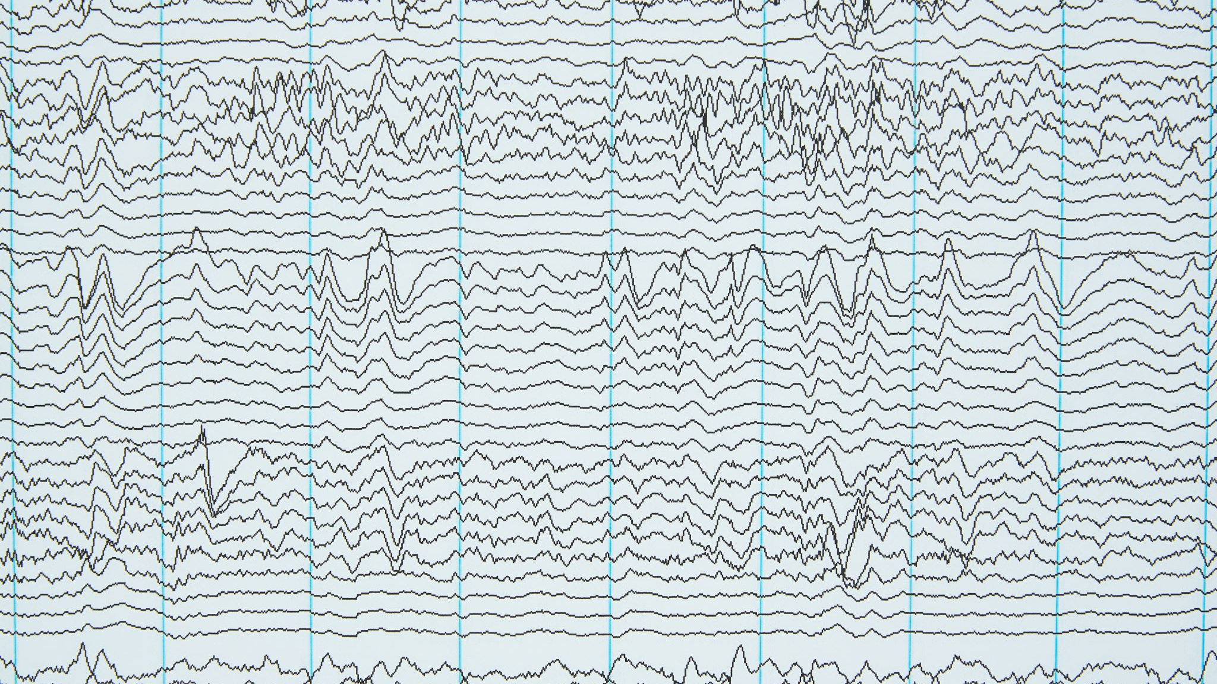
End-of-Module Practice Tasks
Create a line plot with labels, legends, and text annotations.
Generate a bar chart to compare the population of three cities.
Create a subplot containing a histogram, scatter plot, and pie chart.
Plot a sine and cosine curve in the same figure with different styles.
Generate a heatmap for a 5x5 random matrix and add a color bar.

Slide 23
Let's Apply It: Sample Superstore Dataset
The Dataset: A classic practice dataset containing sales, profit, and customer information for a furniture store.
Possible Questions We Can Answer:
What is the total profit?
Which product category is the most profitable?
Which region has the highest sales?
Is there a relationship between discount and profit?

Slide 24
Course Summary
You've learned: The basics of Python, Pandas, and how to navigate the data analysis workflow: Load -> Clean -> Explore -> Visualize.
Remember: Data analysis is a skill. Practice is key!
Next Steps: Try your own projects. Find a dataset on something you love—sports, movies, music—and explore it!

Slide 25

Any Questions?
Contact Info / Further Resources

