Slide 1

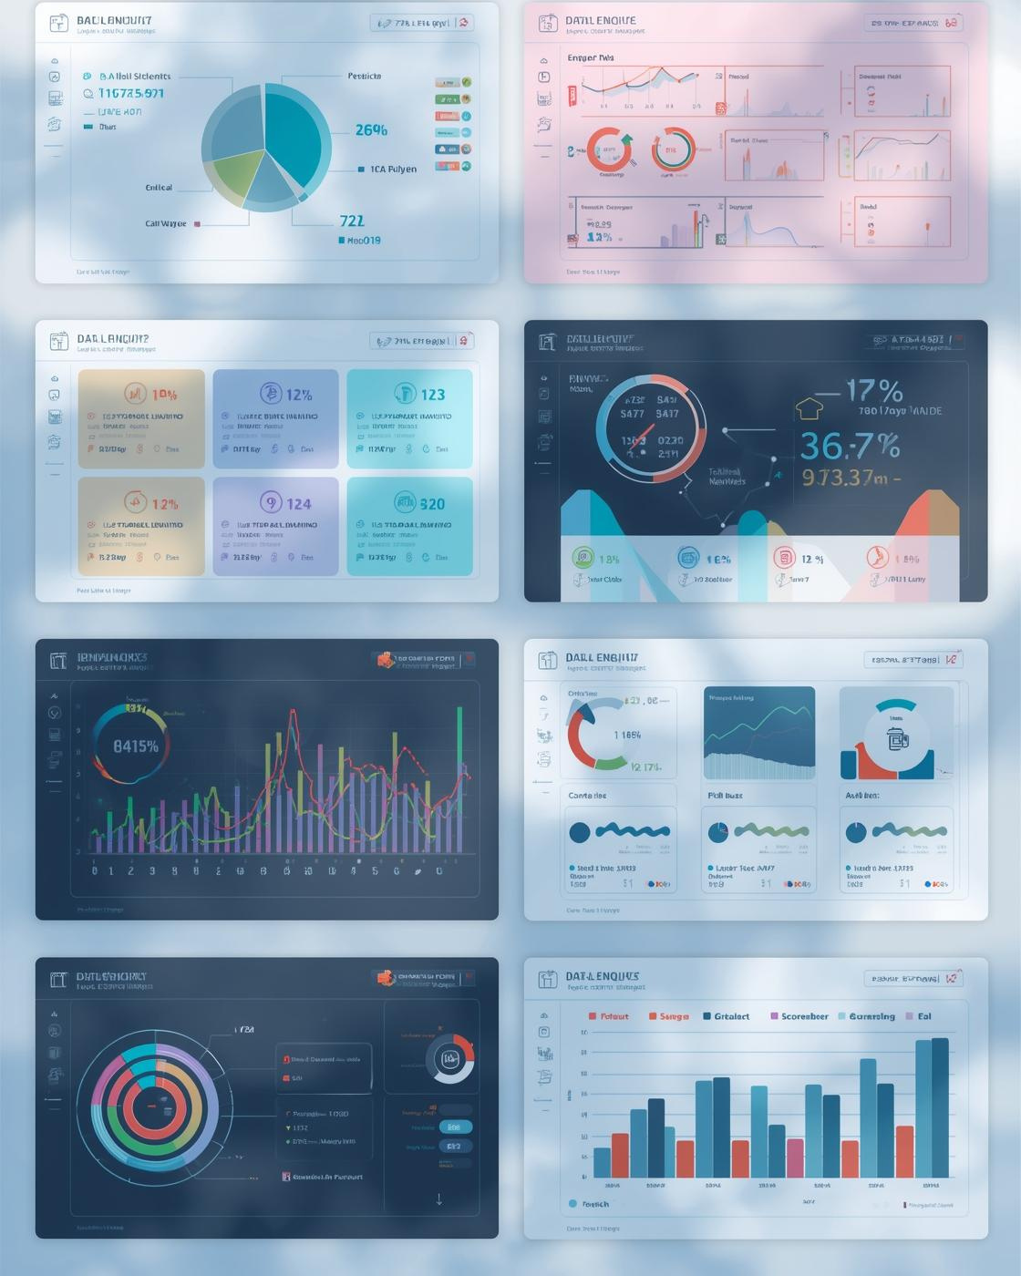
2-Day Google Looker Studio Masterclass
Presented by Chinaza from RKY Careers
December, 2025

Slide 2

Day 1 Agenda
Overview of key topics for today's session
Introduction to Looker Studio and why it matters
Comparison with Excel and Power BI
Connecting data and building reports
Filters, interactions, and hands-on dashboard creation
2

Slide 3

What is Looker Studio?
Free Tool
Interactive Dashboards
Google’s free data visualization tool is user-friendly and powerful.
Create interactive dashboards that enhance your data storytelling experience.
Google Integration
Business Suitability
Seamless integration with Google services ensures smooth data connectivity.
Suitable for marketing, analytics, sales, and operations teams effectively.
3

Slide 4
Why Businesses Use Looker Studio
Real-Time Reporting
Automation
Provides immediate insights and up-to-date business metrics.
Eliminates manual updates, saving time and reducing errors.
Easy Collaboration
Custom Branding
Facilitates sharing dashboards among team members seamlessly.
Allows businesses to create visually appealing and branded dashboards.
4

Slide 5

Looker Studio Comparison
Understanding key differences in tools
Cost
Real-Time Capability
Best Use Cases
Looker Studio is a free tool, while Excel and Power BI operate on a paid model. This makes Looker Studio an accessible option for individuals and businesses alike.
Looker Studio excels in marketing and analytics, particularly for teams using Google products, whereas Excel is better for complex calculations and Power BI is favored for enterprise-level reporting.
Looker Studio offers real-time data visualization, unlike Excel, which requires manual data refreshes, and Power BI, which also provides real-time features but at a cost.
5

Slide 6

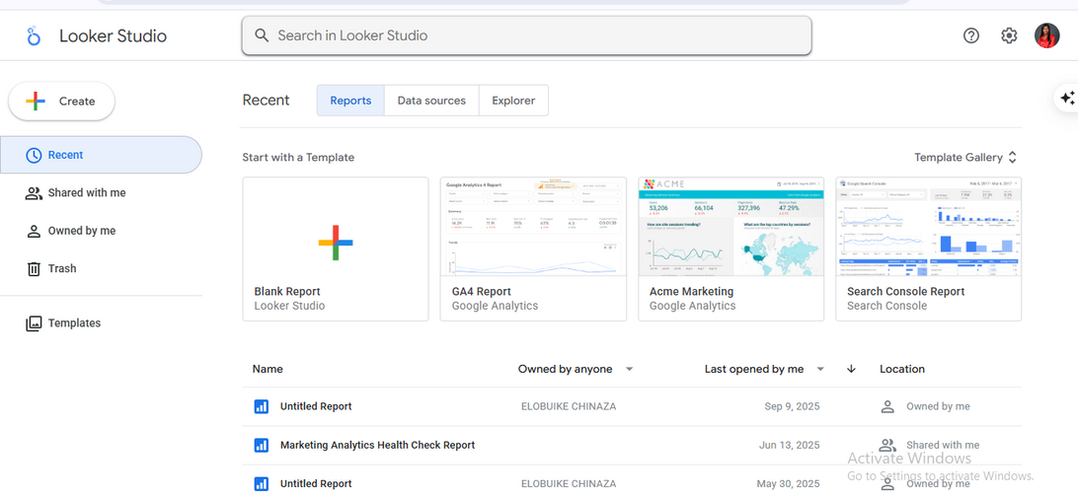
Installing Google looker studio
You don’t need to install anything. Looker Studio is available online for free.
How to Access
  Go to: lookerstudio.google.com
  Sign in with your Google account
  Click Create → Report
6

Slide 7
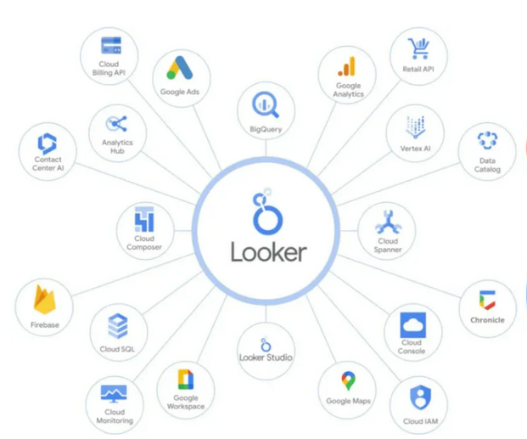
Supported Data Sources
Overview of available data connections
Looker Studio connects to 600+ data sources.
Google Sheets
Databases
Google Sheets is a fundamental data source for Looker Studio, enabling users to easily connect and visualize their data directly from spreadsheets, allowing for dynamic reporting and updates.
Looker Studio supports various databases such as BigQuery and MySQL/SQL, providing robust options for users to connect to larger datasets and perform advanced analytics seamlessly.
Community Connectors
With over 600 community connectors available, Looker Studio allows users to expand their data connectivity options, integrating diverse sources to enhance reporting capabilities and insights.
7

Slide 8
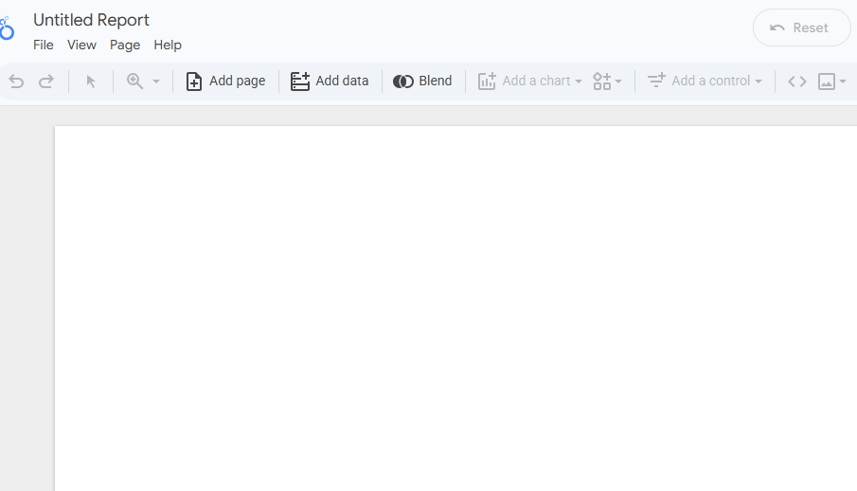
Hands-On: Connect Data
Steps
  Open Looker Studio
  Click Create → Report
  Click Add Data
  Choose Google Sheets
  Select the “Sales Dataset”
  Click Add to Report
Create Report
Open Looker Studio
Select "Create Report" to begin your data connection.
Launch Looker Studio to start building your report.
8

Slide 9
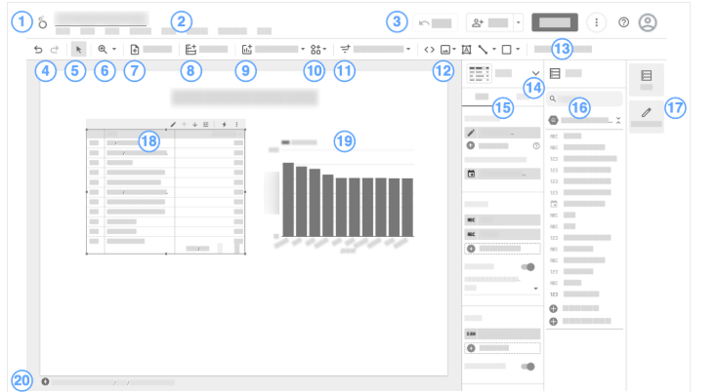
Hands-On: Connect Data
Open Looker Studio
Create Report
Launch Looker Studio to start building your report.
Select "Create Report" to begin your data connection.
9

Slide 10
Building Your First Report
Layout
Scorecards
Branding
Adjust layout for clarity and effective visual storytelling.
Scorecards display key metrics like revenue and orders instantly.
Customize colors and fonts to align with brand identity.
Drill-down
Visuals
Date Range
Interactions enhance data exploration by revealing detailed insights.
Insert bar and column charts to enhance data presentation.
Control allows users to set specific date filters efficiently.
Slicers
Drop-down Filters
Facilitate interaction for regions, products, or categories adjustments.
Enable users to select specific categories for improved analysis.
10

Slide 11
Thank You for Joining Us!

