Slide 1

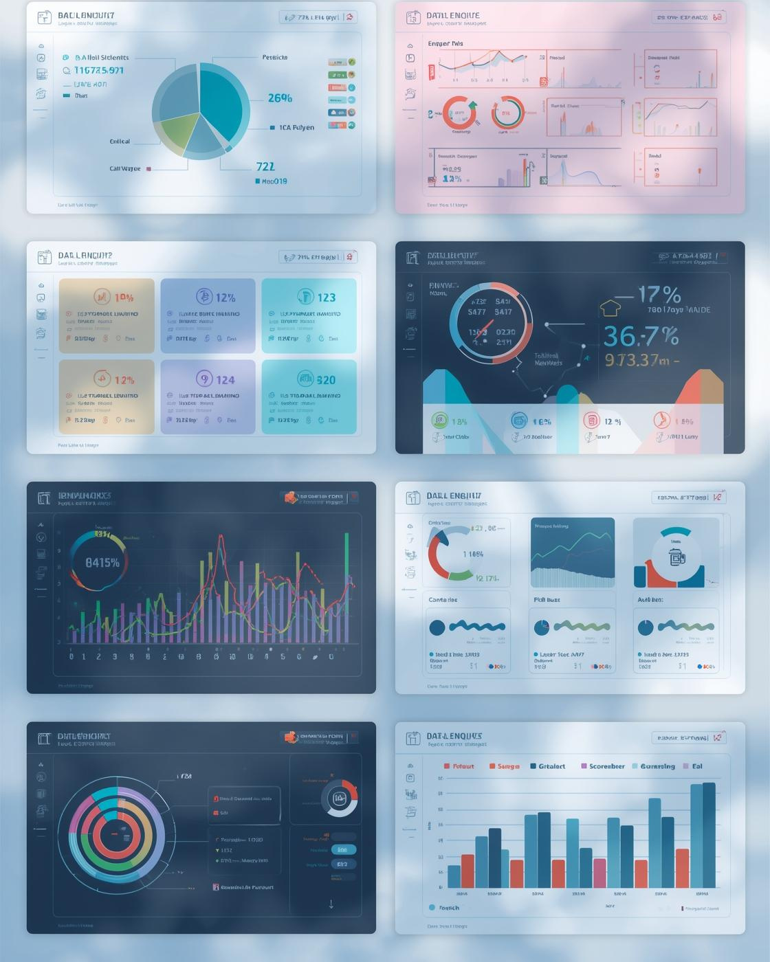
2-Day Google Looker Studio Masterclass
Presented by Chinaza from RKY Careers
December, 2025

Slide 2
Day 2 Agenda
What You’ll Learn Today
  Calculated fields
  Advanced visuals
  Data blending
  Dashboard storytelling
  Building a professional report
2

Slide 3

Calculated Fields
Calculated fields allow you to create new metrics that don’t exist in your dataset.
Common Examples:
  Profit = Revenue − Cost
  Profit Margin = Profit ÷ Revenue
  Conversion Rate = Orders ÷ Sessions
  AOV = Revenue ÷ Orders
Where to Create It:
Sidebar → Add a Field
Steps
Select your data source
Click Add a Field
Enter the formula
Name your field
Click Save
3

Slide 4
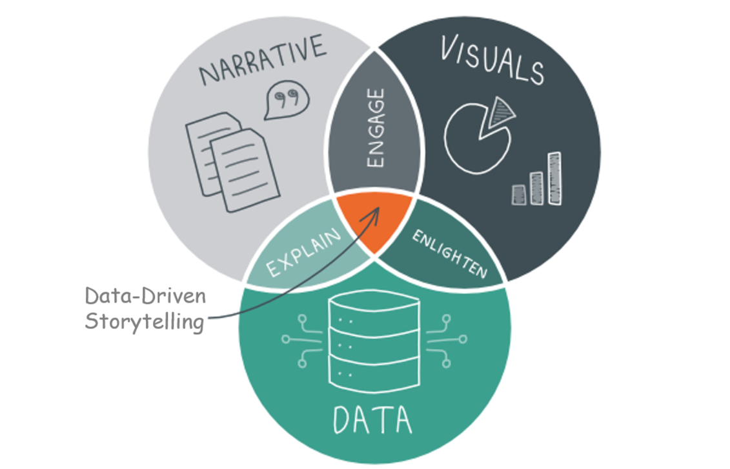
Introduction to Data Storytelling
Using data + visuals + context to explain insights clearly and help people make decisions quickly.
Key Principles:
  Start with the “why” what question is this dashboard answering?
  Highlight key metrics first - place top KPIs at the top.
  Stay consistent with colors – avoid using too many.
  Reduce clutter – remove unnecessary labels & chart noise.
  Add short notes – quick annotations to explain key insights.
4

Slide 5
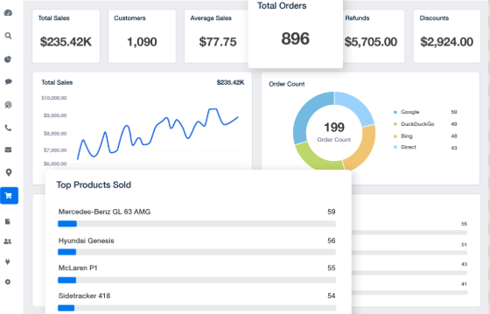

Dashboard Layout Best Practices
Always Structure Your Dashboard:
  Top: KPIs
  Middle: Trends + comparisons
  Bottom: Details (tables)
  Left/Right: Filters
  Use consistent border
  Make fonts readable
  ✔ Use 2–3 colors
Avoid:
  Darkening your layout with heavy colors
  Too many fonts
  Overlapping charts
  Long labels
5

Slide 6
Dashboard Layout Best Practices
Design Tips for Beginners
✔ Use 2–3 colors
✔ Use white space
✔ Make fonts readable (16px+)
✔ Use consistent borders
✔ Avoid unnecessary decoration
✔ Align everything
6

Slide 7
Thank You for Joining Us!

